Slide 1


R. GLENN
HUBBARD
ANTHONY PATRICK
O’BRIEN
FIFTH EDITION
© 2015 Pearson Education, Inc.

Slide 2
Trade Offs, Comparative Advantage, and the Market System

Slide 3
Scarcity and trade-offs
Households, firms and governments continually face decisions about how best to use their scarce resources.
Scarcity: a situation in which unlimited wants exceed the limited resources available to fulfill those wants.
Scarcity requires trade-offs. Economics teaches us tools to help make good trade-offs.
Example: When deciding how to use its scarce workers and machinery, if Tesla wants to produce more Model X SUVs, those resources will not be available to produce Model S sedans.

Slide 4
Production Possibilities Frontiers and Opportunity Costs
2.1
Use a production possibilities frontier to analyze opportunity costs and trade-offs.

Slide 5
Production possibilities frontier
A production possibilities frontier (PPF) is a curve showing the maximum attainable combinations of two products that may be purchases with available resources and technology.
Question: Is the PPF a positive or normative tool?
Answer: Positive; it shows “what is”, not “what should be”.

Slide 6
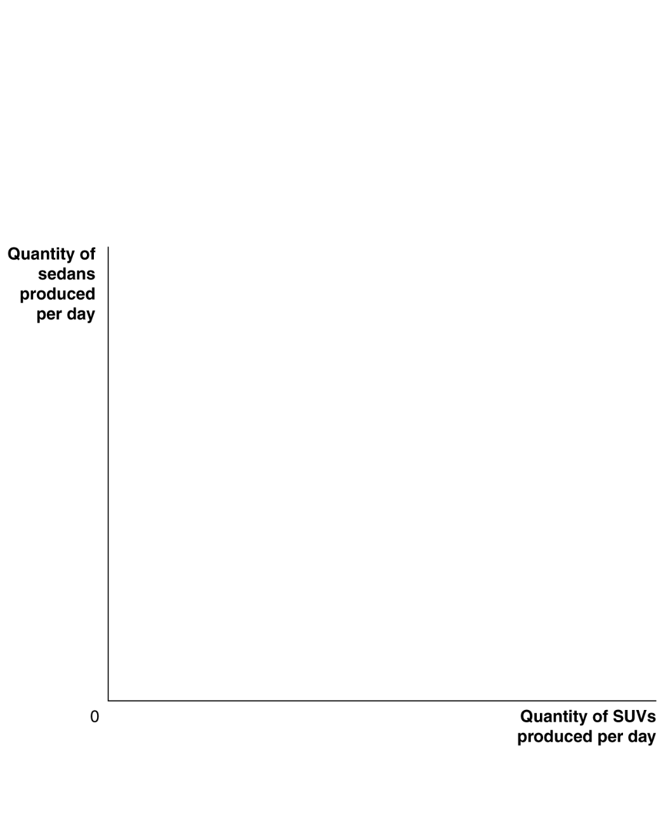
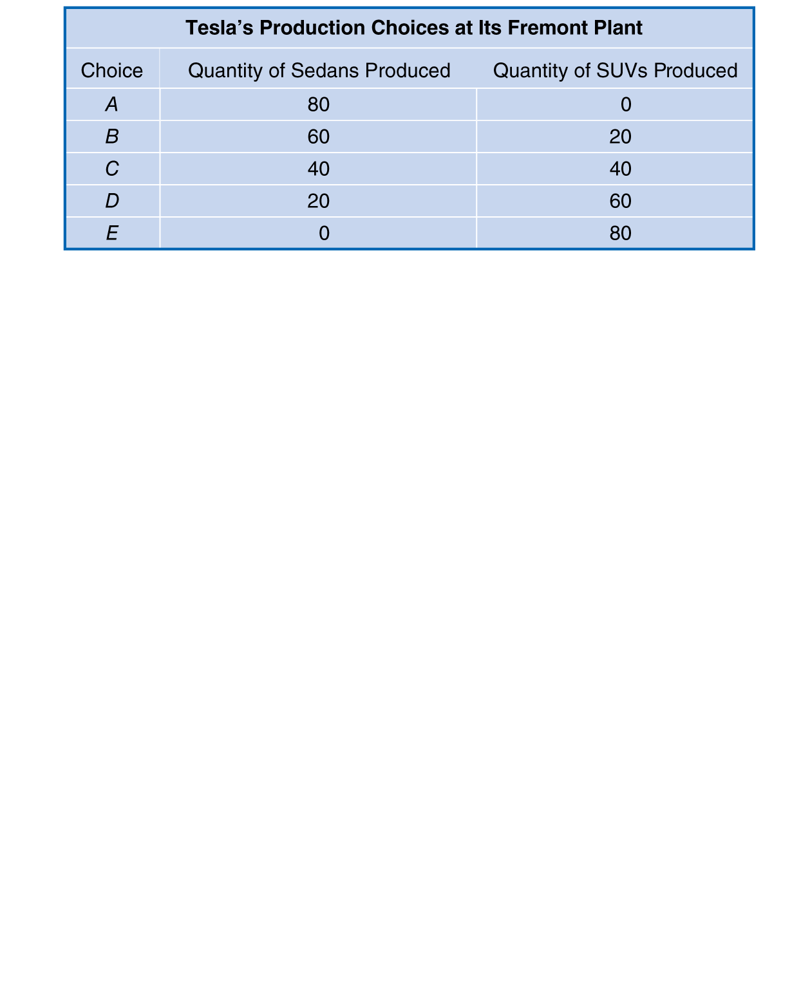

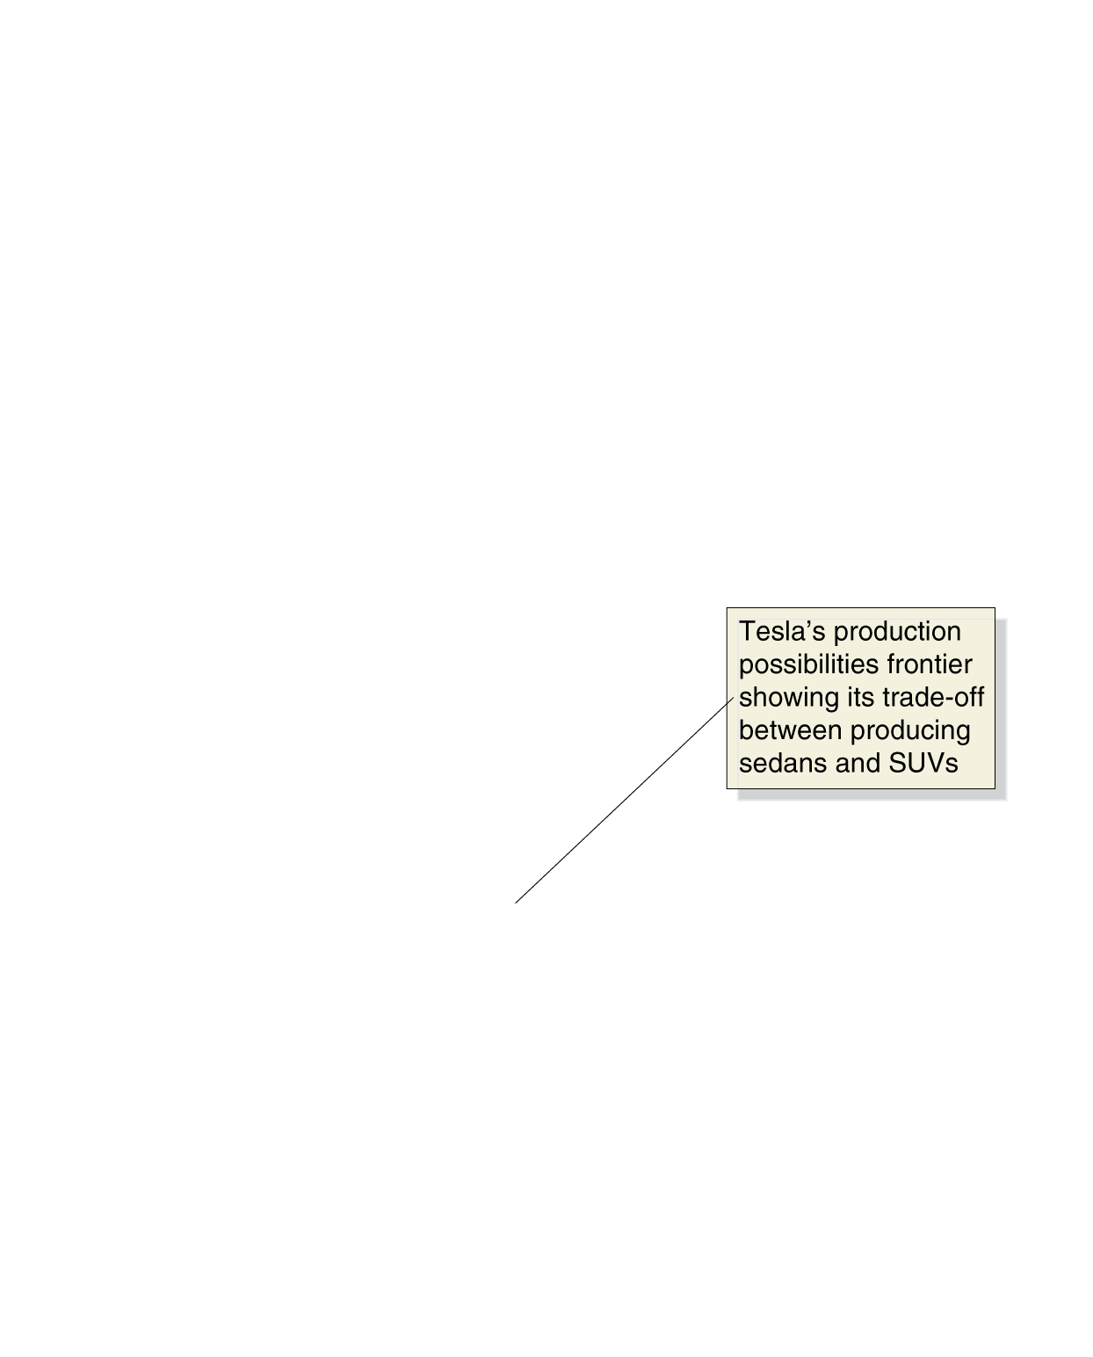

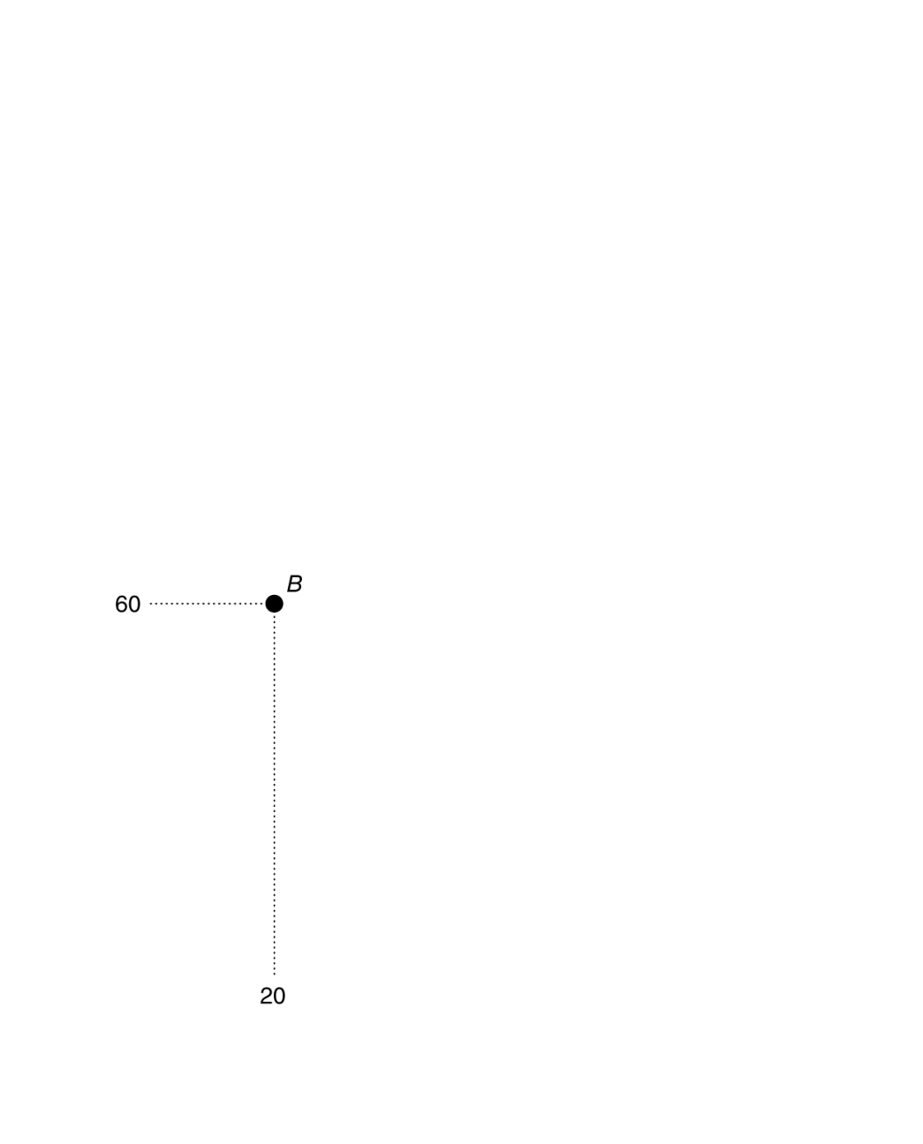

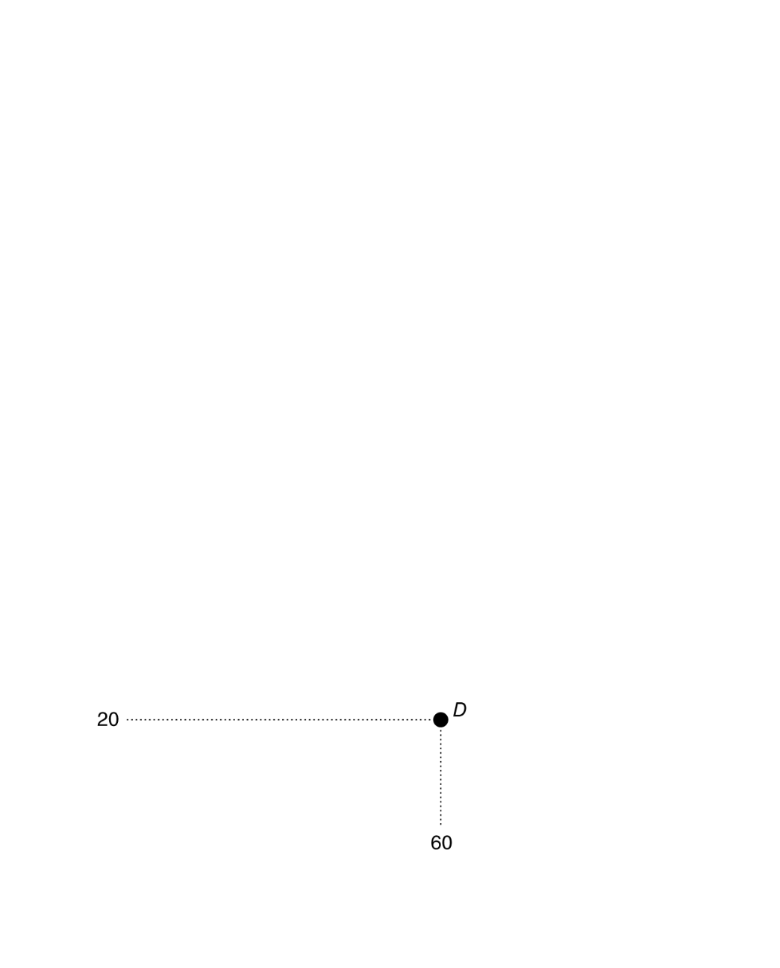

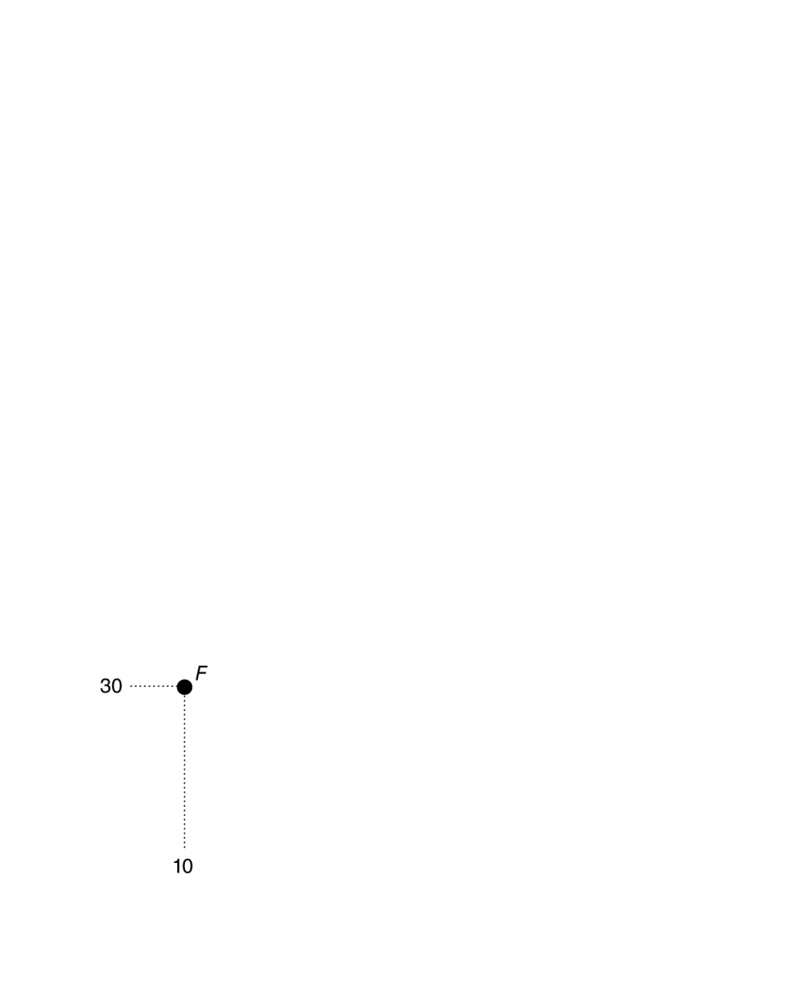


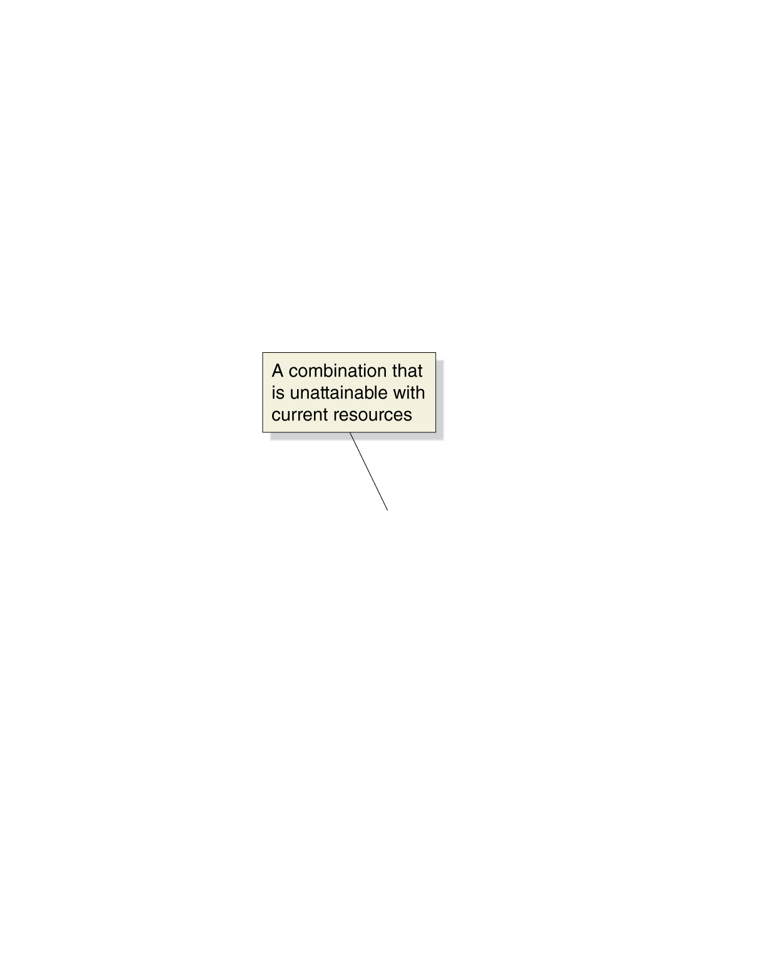
A production possibilities frontier for Tesla
Tesla can produce sedans and/or SUVs.
If it wants to produce more sedans, it must reduce the number of SUVS.
Points on the PPF are attainable for Tesla.
Points below the curve are inefficient.
Points above the curve are unattainable with current resources.
Figure 2.1
Tesla’s production possibilities frontier
Notes:
Tesla faces a trade-off: To build one more
sedan, it must build one fewer SUV. The
production possibilities frontier illustrates
the trade-off Tesla faces. Combinations on
the production possibilities frontier—like
points A, B, C, D, and E—are technically
efficient because the maximum output is
being obtained from the available resources.
Combinations inside the frontier—like
point F—are inefficient because some resources
are not being used. Combinations
outside the frontier—like point G—are
unattainable with current resources.

Slide 7
Tesla can trade off sedans for SUVs
To produce 20 more SUVs (e.g. moving from A to B), Tesla must produce 20 fewer sedans.
The 20 fewer sedans is the opportunity cost of producing 20 more SUVs.
Opportunity cost: The highest-valued alternative that must be given up to engage in an activity.
Figure 2.1
Tesla’s production possibilities frontier

Slide 8
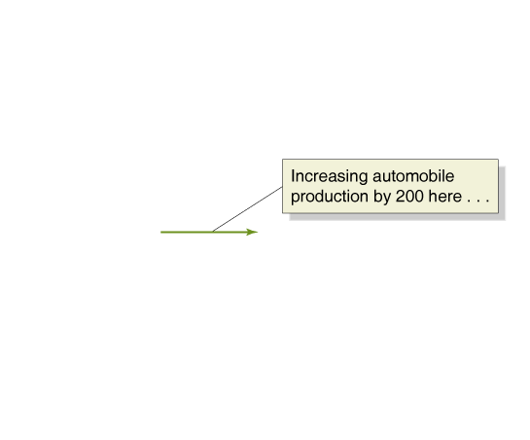
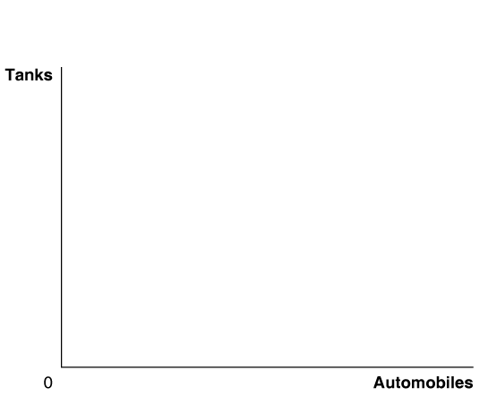
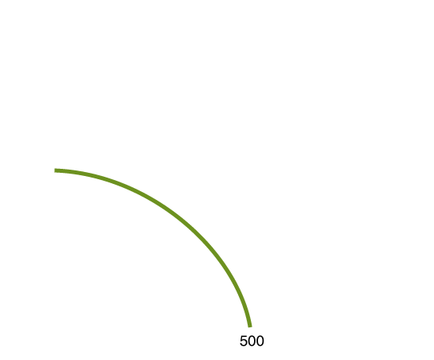
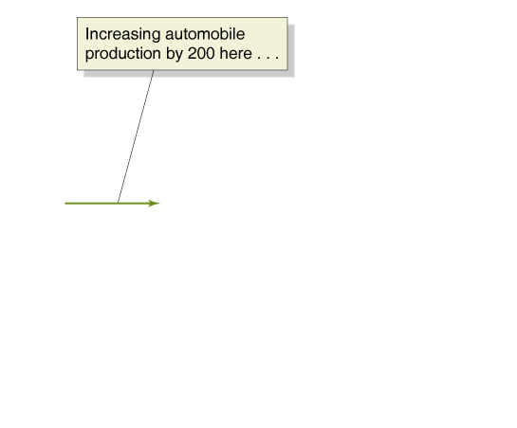

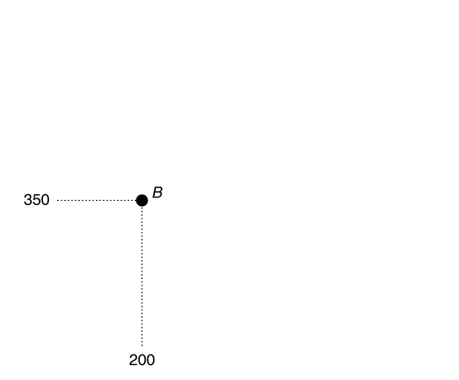
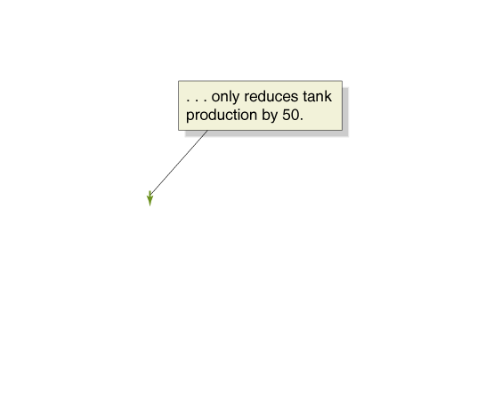
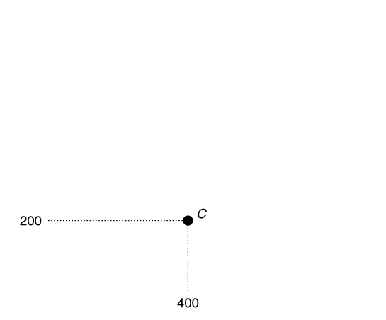
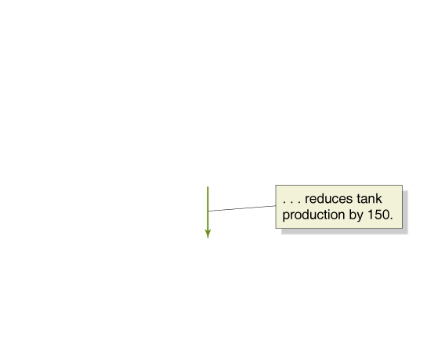
Increasing marginal opportunity costs
On the previous slide, opportunity costs were constant.
But opportunity costs are often increasing.
Why? Some resources are better suited to one task than another. The first resources to “switch” are the one best suited to switching.
Figure 2.2
Increasing marginal opportunity costs
The more resources already devoted to an activity, the smaller the payoff to devoting additional resources to that activity.
Notes:
As the economy moves down the production
possibilities frontier, it experiences
increasing marginal opportunity costs because
increasing automobile production by
a given quantity requires larger and larger
decreases in tank production. For example,
to increase automobile production from 0 to
200—moving from point A to point B—the
economy has to give up only 50 tanks. But to
increase automobile production by another
200 vehicles—moving from point B to point
C—the economy has to give up 150 tanks.

Slide 9
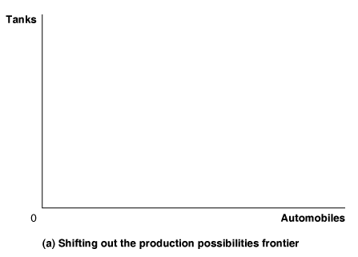

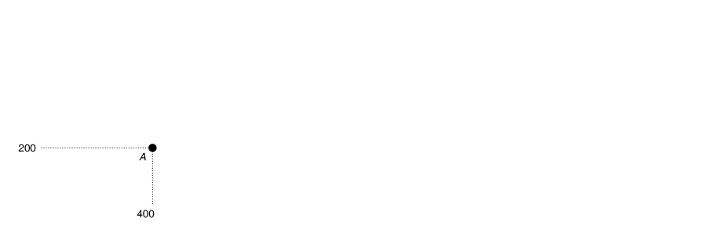




Economic growth on the PPF
As more economic resources become available, the economy can move from point A to point B, producing more tanks and more automobiles.
Shifts in the production possibilities frontier represent economic growth.
Figure 2.3a
Economic growth
Economic growth: the ability of the economy to increase the production of goods and services.
Notes:
Panel (a) shows that as more economic resources become available and technological
change occurs, the economy can move from point A to point B, producing more
tanks and more automobiles. Panel (b) shows the results of technological change in
the automobile industry that increases the quantity of vehicles workers can produce
per year while leaving unchanged the maximum quantity of tanks they can produce.
Outward shifts in the production possibilities frontier represent economic growth.

Slide 10


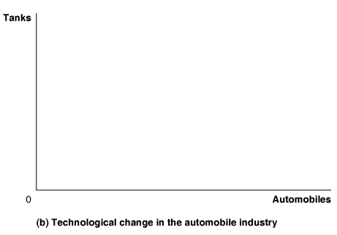
Technological change in one industry
This panel shows technological improvement in the automobile industry.
The quantity of tanks that can be produced remains unchanged.
As in the previous slide, many previously unattainable combinations are now attainable.
Figure 2.3b
Economic growth

Slide 11
A PPF for exam grades
Suppose you have a limited amount of time to study for two exams, Economics and Accounting.
What would the production possibilities curve for the exam grades look like?
A straight line, like the PPF for sedans and SUVs
or
A bowed-outward curve, like the PPF for tanks and automobiles?
Why? The first hour spent studying Economics is much more valuable than the last hour…

Slide 12
Comparative Advantage and Trade
2.2
Describe comparative advantage and explain how it serves as the basis for trade.

Slide 13
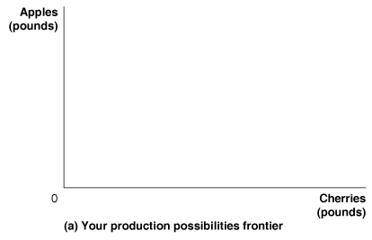
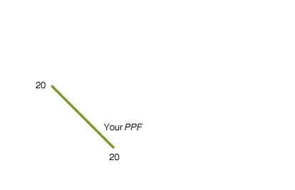
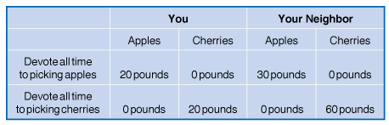
PPFs for picking apples and cherries
You and your neighbor each have a limited time to pick cherries and/or apples.
If you spend your time picking cherries, you can pick 20 pounds of cherries.
If you spend you time picking apples, you can pick 20 pounds of apples.
Figure 2.4a
Production possibilities for you and your neighbor, without trade
Notes:
The table shows how many pounds of apples and how many pounds of cherries
you and your neighbor can each pick in one week. The graphs use the data from
the table to construct PPFs for you and your neighbor. Panel (a) shows your PPF.
If you devote all your time to picking apples and none to picking cherries, you
can pick 20 pounds. If you devote all your time to picking cherries, you can pick
20 pounds. Panel (b) shows that if your neighbor devotes all her time to picking
apples, she can pick 30 pounds. If she devotes all her time to picking cherries, she
can pick 60 pounds.

Slide 14
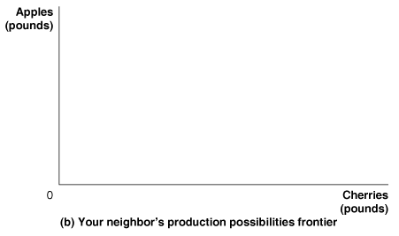
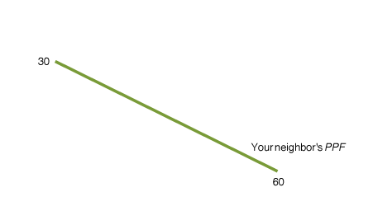
PPFs for picking apples and cherries—continued
If your neighbor spends all of her time picking cherries, she can pick 60 pounds of cherries.
If your neighbor spends all of her time picking apples, she can pick 30 pounds of apples.
Figure 2.4b
Production possibilities for you and your neighbor, without trade

Slide 15
Specialization and trade
What if you and your neighbor decided to specialize and trade?
Trade: The act of buying and selling.
Could your neighbor benefit from trade? She is better at picking both apples and cherries…
Both of you can benefit from trade, by specializing in what you are relatively good at. Let’s see how…

Slide 16
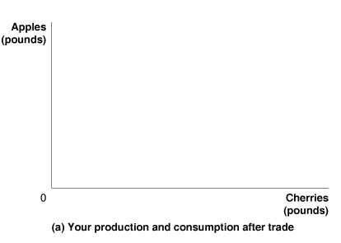
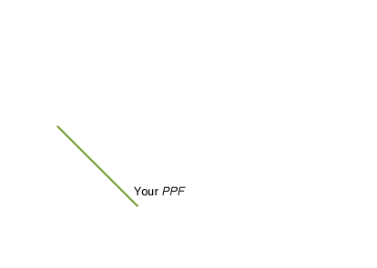
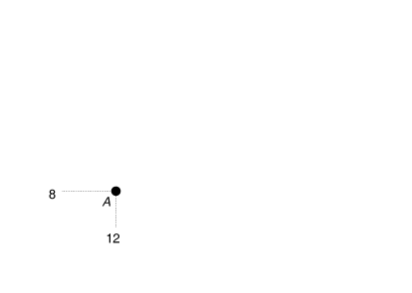
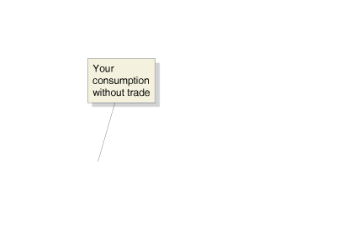
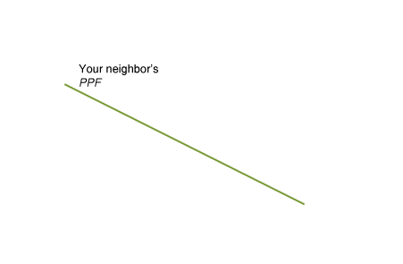
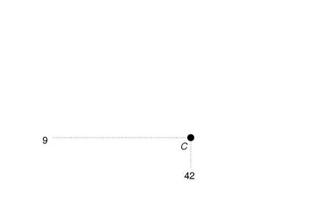
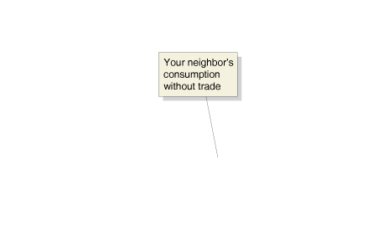
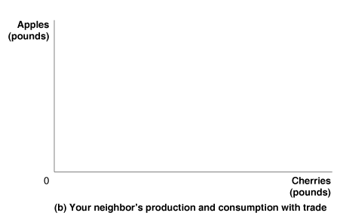
Gains from specialization and trade
Figure 2.5
Gains from trade
When you don’t trade with your neighbor, you pick and consume 8 pounds of apples and 12 pounds of cherries per week—point A in panel (a).
When your neighbor doesn’t trade with you, she picks and consumes 9 pounds of apples and 42 pounds of cherries per week—point C in panel (b).
Notes:
When you don’t trade with your neighbor, you pick and consume 8 pounds of
apples and 12 pounds of cherries per week—point A in panel (a). When your
neighbor doesn’t trade with you, she picks and consumes 9 pounds of apples and
42 pounds of cherries per week—point C in panel (b). If you specialize in picking
apples, you can pick 20 pounds. If your neighbor specializes in picking cherries,
she can pick 60 pounds. If you trade 10 pounds of your apples for 15 pounds of
your neighbor’s cherries, you will be able to consume 10 pounds of apples and
15 pounds of cherries—point B in panel (a). Your neighbor can now consume 10
pounds of apples and 45 pounds of cherries—point D in panel (b). You and your
neighbor are both better off as a result of the trade.

Slide 17
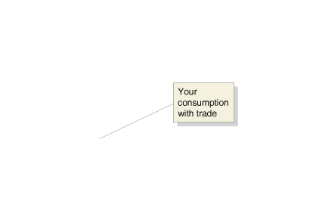
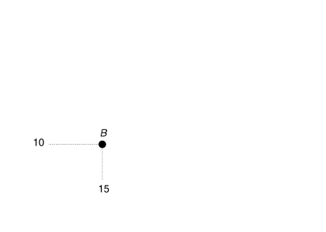
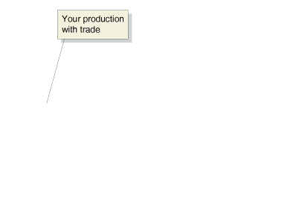
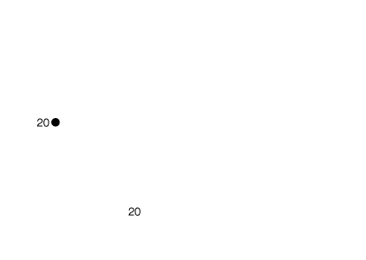


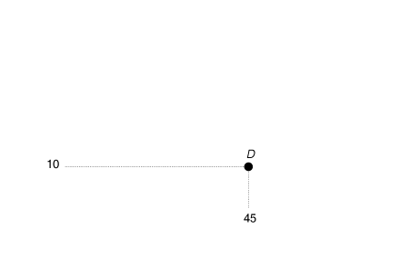

Gains from specialization and trade—continued
Figure 2.5
Gains from Trade
If you specialize in picking apples, you can pick 20 pounds. If your neighbor specializes in picking cherries, she can pick 60 pounds.
If you trade 10 pounds of your apples for 15 pounds of your neighbor’s cherries, you will be able to consume 10 pounds of apples and 15 pounds of cherries— point B in panel (a).
Your neighbor can now consume 10 pounds of apples and 45 pounds of cherries—point D in panel (b). You and your neighbor are both better off as a result of trade.

Slide 18
Summary of the gains from trade
 | You |  | Your Neighbor
 | Apples (in pounds) | Cherries (in pounds) | Apples (in pounds) | Cherries (in pounds)
Production and consumption without trade | 8 | 12 | 9 | 42
Production with trade | 20 | 0 | 0 | 60
Consumption with trade | 10 | 15 | 10 | 45
Gains from trade (increased consumption) | 2 | 3 | 1 | 3
Table 2.1
A summary of the gains from trade

Slide 19
Explaining the gains from specialization and trade
How could both of you benefit from trade, when your neighbor was so much better than you?
Economists say your neighbor had an absolute advantage in both cherry- and apple-picking, but you had a comparative advantage in picking apples.
Absolute advantage: The ability of an individual, a firm, or a country to produce more of a good or service than competitors, using the same amount of resources.
Comparative advantage: The ability of an individual, a firm, or a country to produce a good or service at a lower opportunity cost than competitors.

Slide 20
Comparative advantage and the gains from trade
 | Opportunity Cost of Picking 1 Pound of Apples | Opportunity Cost of Picking 1 Pound of Cherries
You | 1 pound of cherries | 1 pound of apples
Your Neighbor | 2 pounds of cherries | 0.5 pound of apples
Table 2.2
Opportunity costs of picking apples and cherries
The basis for trade is comparative advantage, not absolute advantage.
Individuals, firms, and countries are better off if they specialize in producing goods and services for which they have a comparative advantage and obtain the other goods and services they need by trading.

Slide 21
Comparative advantage and housework
People living together have to divide up household chores.
Basic economic concepts like comparative advantage can provide useful insight in the division of labor.
Suppose Jack is faster than Jill at both cooking and laundry. However:
Jack is MUCH faster at preparing tasty meals, while
Jack is only a little faster at doing laundry
Jack’s comparative advantage is in cooking—to cook a tasty meal, he gives up the opportunity to perform less laundry than Jill—so he should specialize in this, while Jill specializes in laundry.

Slide 22
The Market System
2.3
Explain the basic idea of how a market system works.

Slide 23
The two key groups in a modern economy
Two key groups participate in the modern economy:
Households consist of individuals who provide the factors of production: labor, capital, natural resources, and entrepreneurial ability.
  Households receive
  payments for these factors
  by selling them to firms in factor markets.
Firms supply goods and services to product markets; households buy these products from the firms.
All types of work
Physical capital used to produce other goods
Land, water, oil, ore, raw materials, etc.
The ability to bring together factors of production

Slide 24
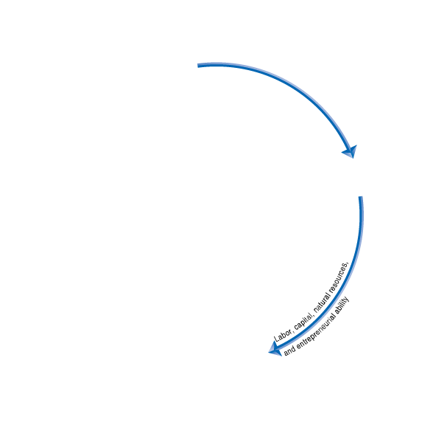
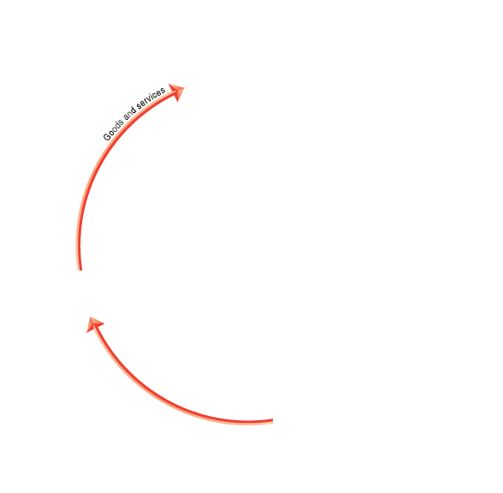
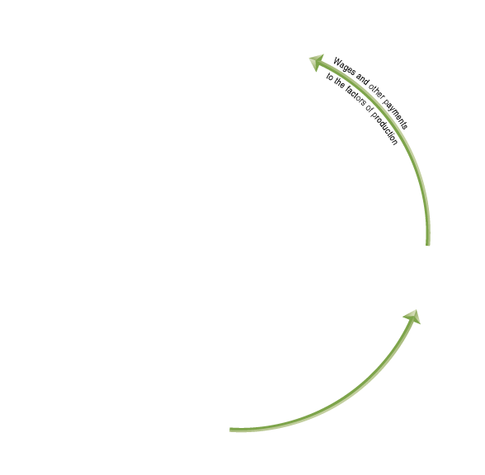
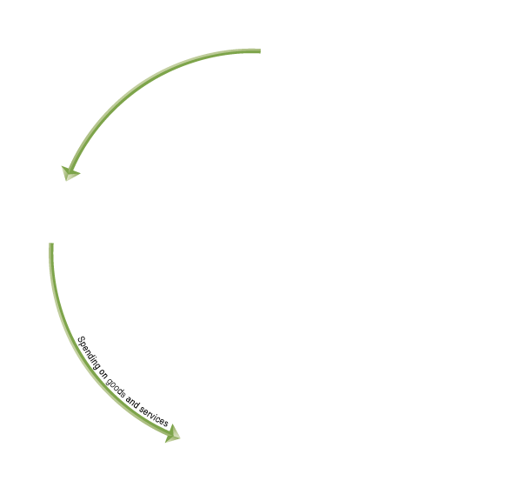


The circular flow diagram
Circular-flow diagram: A model that illustrates how participants in
markets are linked.
Households provide factors of production to firms.
Firms provide goods and
services to households.
Firms pay money to
households for the
factors of production.
Households pay money to
firms for the goods and services.
Figure 2.6
The circular-flow diagram
Notes:
Households and firms are linked together in
a circular flow of production, income, and
spending. The blue arrows show the flow of
the factors of production. In factor markets,
households supply labor, entrepreneurial
ability, and other factors of production to
firms. Firms use these factors of production
to make goods and services that they supply
to households in product markets. The red
arrows show the flow of goods and services
from firms to households. The green arrows
show the flow of funds. In factor markets,
households receive wages and other payments
from firms in exchange for supplying
the factors of production. Households use
these wages and other payments to purchase
goods and services from firms in product
markets. Firms sell goods and services to
households in product markets, and they
use the funds to purchase the factors of production
from households in factor markets.

Slide 25
The circular flow diagram—a simplified model
Like all economic models, the circular flow diagram is a simplified version of reality:
No government
No financial system
No foreign buyers and sellers of goods
We will explore these sectors in later chapters.
Figure 2.6
The circular-flow diagram

Slide 26
The gains from free markets
A free market is one with few government restrictions on how a good or service can be produced or sold, or on how a factor of production can be employed.
Countries that come closest to the free market benchmark have been more successful than those with centrally planned economies in providing their people with rising living standards.
This concept is not new: Adam Smith argued for free markets in his 1776 treatise, An Inquiry into the Nature and Causes of the Wealth of Nations.

Slide 27
The beauty of the market mechanism
It is not immediately obvious that markets will do better than centrally-planned systems for satisfying human desires.
After all, individuals are acting only in their own rational self-interest.
But markets with flexible prices allow the collective actions of households and firms to signal the relative worth of goods and services.
In this way, the “invisible hand” allows individual responses to collectively end up satisfying the wants of consumers.

Slide 28

A story of the market system in action
How do you make an iPad?
Although Apple engineers designed the iPad, Apple does not manufacture iPad components, nor does it assemble the final product.
Hundreds of firms are involved; many probably don’t even know their products will be used in an iPad.
But guided by their own self-interest, they all contribute to the final product—without any desire to enrich Apple or provide enjoyment for iPad purchasers.

Slide 29
The role of the entrepreneur
An entrepreneur is someone who brings together the factors of production—land, labor, and capital—to produce goods and services.
The best entrepreneurs create products that consumers never even knew they wanted.
“If I had asked my customers what they wanted, they would have said a faster horse.”
- Henry Ford
Entrepreneurs make a vital contribution to economic growth, often with considerable personal risk and sacrifice.

Slide 30
Selected products and their inventors
Entrepreneurs make a vital contribution to economic growth by
Responding to consumer demand
Introducing new products
Government policies encouraging entrepreneurship are likely to increase economic growth and raise standards of living.
Product | Inventor
Air conditioning | William Haviland Carrier
Airplane | Orville and Wilbur Wright
Automobile, mass produced | Henry Ford
Biomagnetic imaging | Raymond Damadian
Biosynthetic insulin | Herbert Boyer
DNA fingerprinting | Alec Jeffries
… | …
Vacuum tube | Philo Farnsworth
Zipper | Gideon Sundback
Table 2.3
Important products introduced by entrepreneurs

Slide 31
The legal basis of a successful market system
In a free market, government does not restrict how firms produce and sell goods, or how they employ factors of production.
However governments must provide a sound legal environment that will allow the market system to succeed, including:
Protection of private property
When criminals can take your wages or profits, households and firms have little incentive to work hard.
Property rights, including intellectual property, are key.
Enforcement of contracts and property rights
Important for transactions across time to occur.
An independent court system is critical here.

Slide 32

Who owns The Wizard of Oz?
Copyrights and patents protect the intellectual property of creators and inventors, in order to encourage innovation.
But sometimes they work against innovation; for example, when Disney wanted to remake the classic 1939 movie The Wizard of Oz, they had to change many details to avoid infringing on Warner Bros’ copyright.
While copyrights provide essential protections, these do not come without costs.

Slide 33
Common misconceptions to avoid
The production possibilities frontier should never bow inward (why?).
The PPF tells us what can be produced, not what should be produced.
Just because someone is better or worse at everything, doesn’t mean trade with them cannot be beneficial.
The basis for trade is comparative advantage, not absolute advantage!
Free markets raise the standard of living; but that doesn’t mean there is no role for governments.
Governments must provide a sound legal environment to allow the market system to succeed.

